Slide 1


Measuring the prompt component of the atmospheric muon flux Pascal Gutjahr and Mirco Hünnefeld
Spring Collaboration Meeting Münster
March 18, 2024
Source: NASA

Slide 2
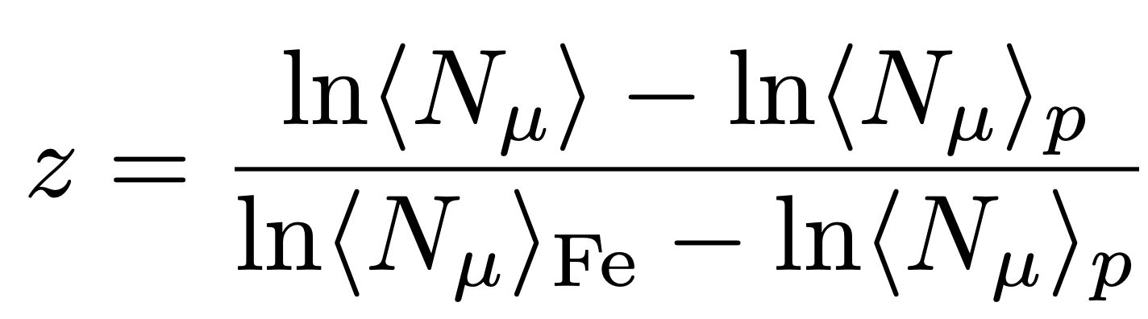
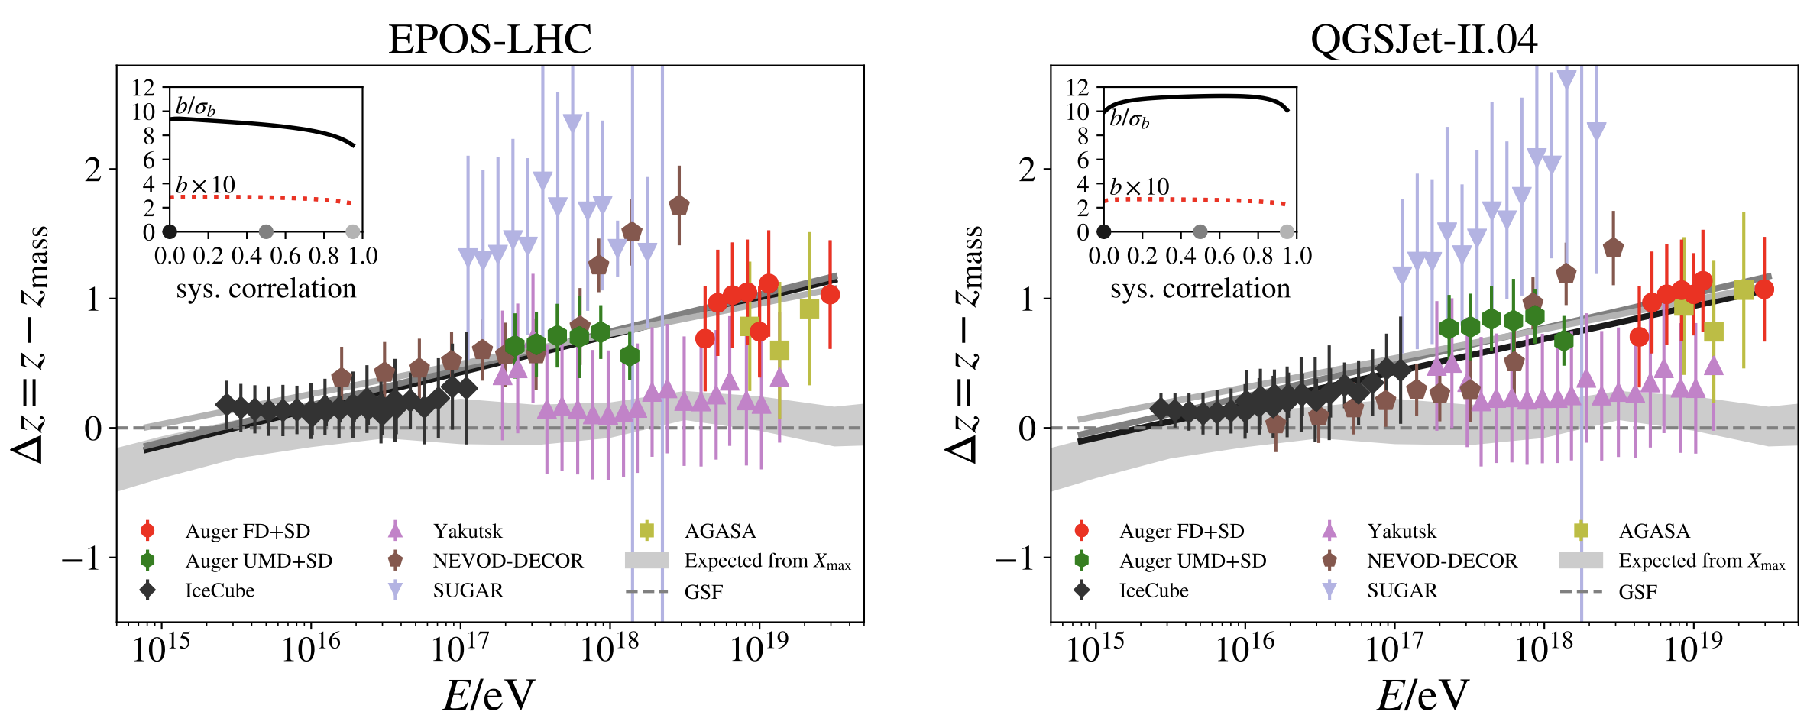
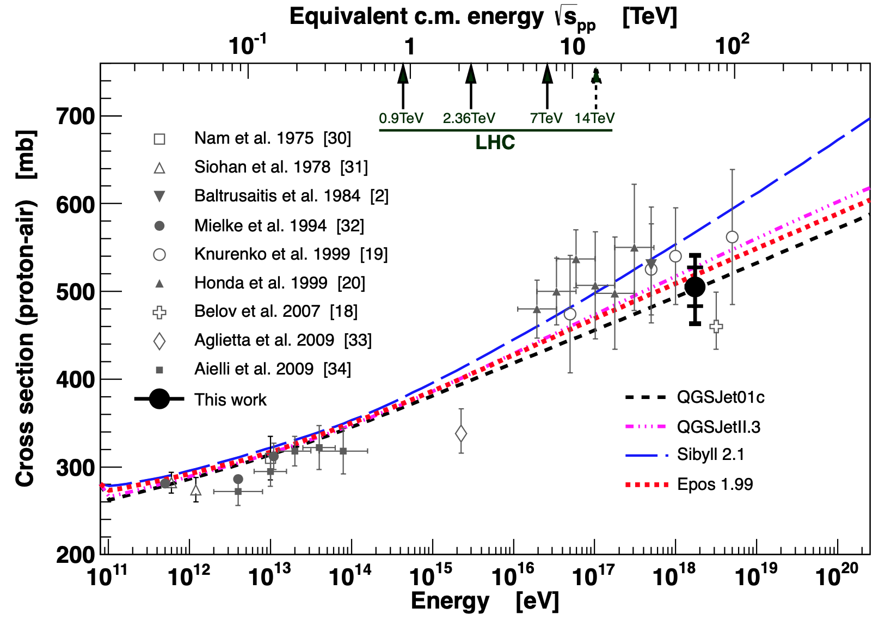
Motivation: muon Puzzle and model uncertainties
”muon number”
Expected z
(“muon number”)
2108.08341
1208.1520
More muons measured than simulated for E > 40 PeV ~ cms 8 TeV
Precise pion/kaon ratio measurement needed
Large uncertainties at E > 10 PeV

Slide 3
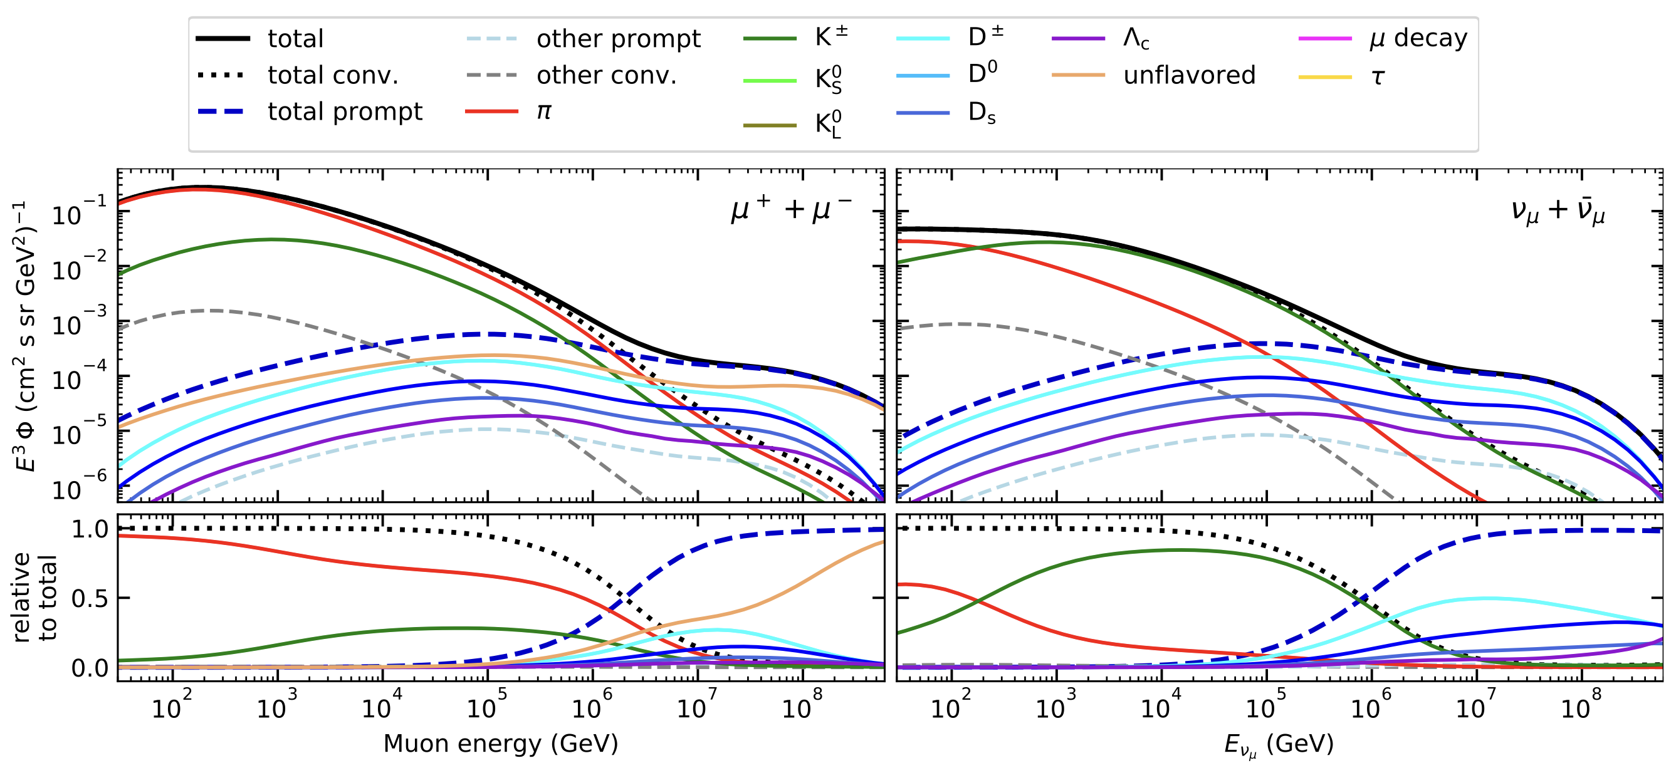
The origin of atmospheric muons and neutrinos
10.1103/PhysRevD.100.103018
no unflavored
dominated by pions
dominated by kaons
Combined fit:
handle on pion/kaon ratio
handle on charmed mesons

Slide 4
Analysis goals
Unfolding of an atmospheric muon spectrum
No prior / model independent
Measuring the normalization of the prompt component of the atmospheric muon flux
Forward fit for a specific model
Future goals
Measure normalization of atmospheric prompt neutrino flux
Combined muon + neutrino fit
Most energetic muon inside
Muon parent:
pion or kaon
yes
no
conventional
prompt
requires new simulation

Slide 5
Overview
Analysis
Simulation
Reconstruction
Selection
Forward fit
Dataset
CORSIKA 77420 Ehist
SIBYLL 2.3d
600 GeV – 50 EeV
DNN reconstructions
Muon energies
Muon direction
Track geometry
Level 3
L2 muon filter
200 TeV bundle energy cut at surface
Add labels
Fit prompt normalization
Poisson LLH fit
Validation
Tag prompt / conv particles
MCEq comparisons
Unfolding
Level 4
Add DNN reconstructions
Muon spectrum
Unfold muon flux
Level 5
Data-MC quality cuts

Slide 6
Simulation

Slide 7

CORSIKA 7 tagging and MCEq comparison
MCEq: tool to numerically solve the cascade equations that describes the evolution of particle densities as they propagate through a gaseous, dense medium
https://github.com/mceq-project/MCEq
GSF weighting
GSF weighting
Good agreement in total prompt and conventional muon flux
D⁰ and D_{s} are swapped here but this is fixed in MCEq
presented in Grand Rapids
New simulation: /data/sim/IceCube/2023/generated/CORSIKA_EHISTORY

Slide 8
Forward Fit

Slide 9
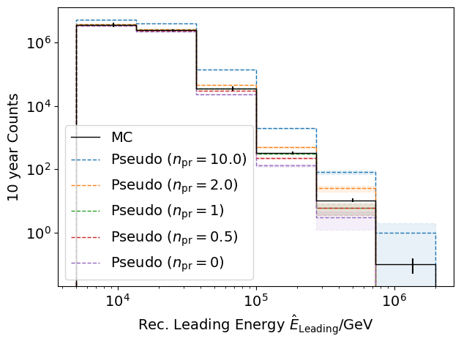
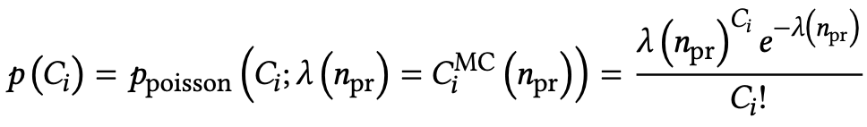
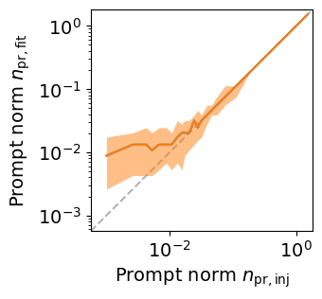
Poisson likelihood forward fit
Cuts:
L2 MuonFilter
Bundle energy at entry > 100 TeV
Tagging allows scaling of prompt by factor n_{pr}
Bias starts at a prompt normalization of 0.1
presented in Grand Rapids

Slide 10
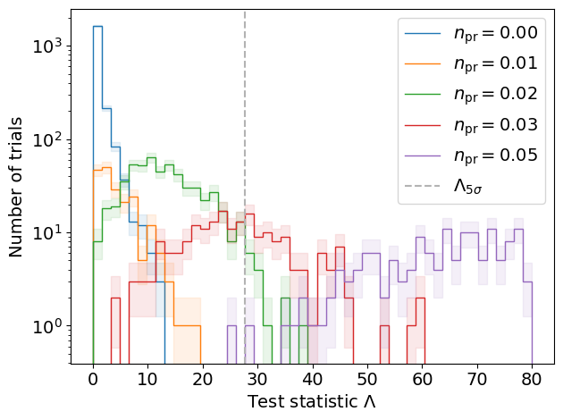
Discovery potential and sensitivity
Cuts:
L2 MuonFilter
Bundle energy at entry > 100 TeV
Expectation for 1 year:
5 sigma discovery potential: 0.102 ± 0.005
Sensitivity: 0.024 ± 0.001
Expectation for 10 years:
5 sigma discovery potential: 0.032 ± 0.001
Sensitivity: 0.007 ± 0.000
Caution:
Limited MC statistics -> events are oversampled in pseudo dataset
No systematics
Tested NNMFit
presented in Grand Rapids

Slide 11
Unfolding

Slide 12
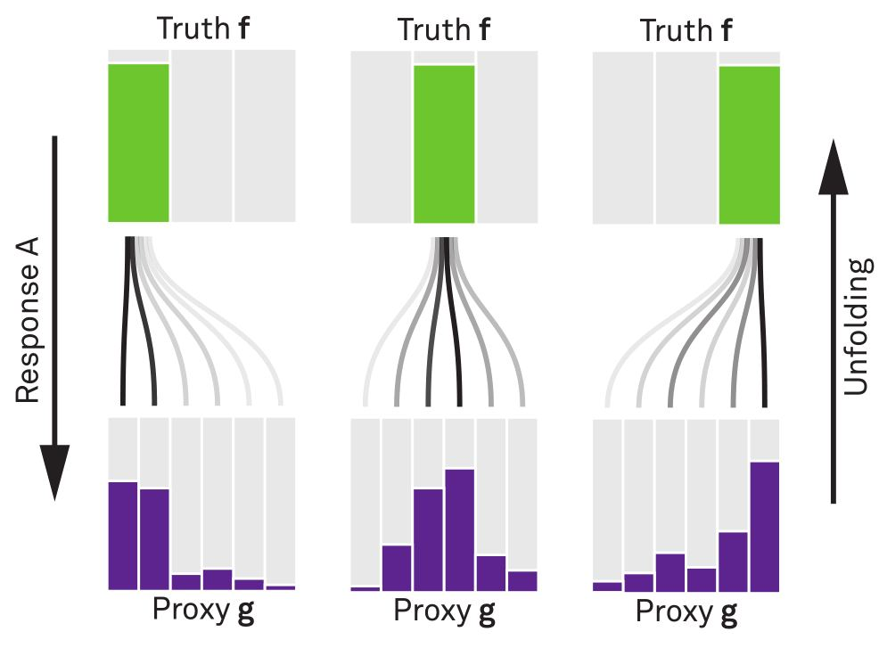


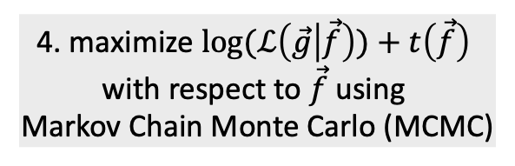
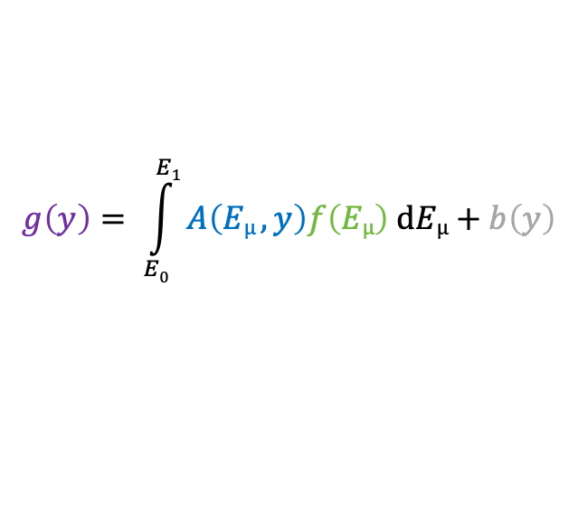
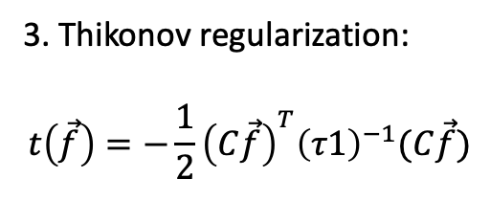
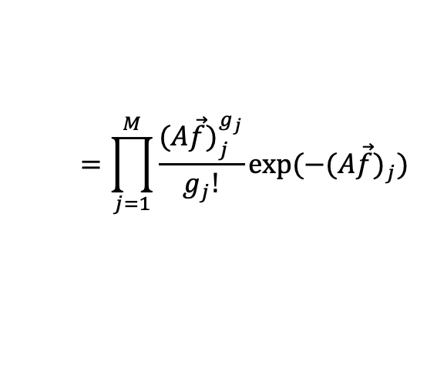
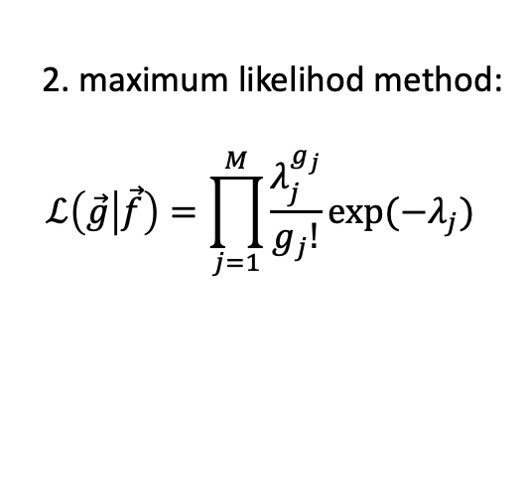
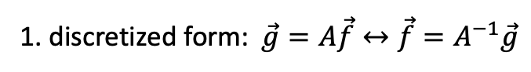
Unfolding in a nutshell
folding
unfolding
1. discretized form: $\vec{g}=A\vec{f}↔\vec{f}=A^{−1}\vec{g}$
measured proxy
detector response
background
$$g\left(y\right)= \int_{E0}^{E1}{A\left(Eµ , y\right)f\left(Eµ\right) dEµ+b\left(y\right) }$$
2. maximum likelihod method:
$$ℒ\left(\vec{g} | \vec{f}\right)=\prod_{j=1}^{M}{\frac{λ_{j}^{g_{j}}}{g_{j}!}exp⁡(−λ_{j})}$$
3. Thikonov regularization:
$$t\left(\vec{f}\right)=−\frac{1}{2}{\left(C\vec{f}\right)}^{T}{\left(τ1\right)}^{−1}(C\vec{f})$$
true energy distribution
$$=\prod_{j=1}^{M}{\frac{{(A\vec{f})}_{j}^{g_{j}}}{g_{j}!}exp⁡(−{(A\vec{f})}_{j})}$$
funfolding
by M. Börner
4. maximize $log⁡(ℒ\left(\vec{g} | \vec{f}\right))+t\left(\vec{f}\right)$
with respect to $\vec{f}$ using
Markov Chain Monte Carlo (MCMC)
Credit: T. Hoinka

Slide 13
Unfolding of event rate – leading muons
Target
little statistics
Proxy
Unfolding of event rate works well

Slide 14
Unfolding of flux – leading muons
oversampling
little statistics
Successful unfolding of muon flux

Slide 15
Conclusion & outlook
✓
CORSIKA 7 Ehist test simulation
Tag prompt / conv particles
Compare with MCEq
Reconstructions
Selection
Level 3 (muon filter + 200 TeV cut + labels)
Level 4 (add reconstructions)
Level 5 (quality cuts)
Data-MC
Forward fit
Performed on pseudo dataset
Unfolding
Performed on pseudo dataset
ToDos
Systematics (too little statistics)
Large-scale simulation (IceProd)
Latest ice model
Latest software release
Storage request
Prompt muons wiki
✓
✓
✓
✓
✓
✓
✓
✓
✓
Request for WG reviewer
✓
Thank you for your attention! ☺️

Slide 16
Backup

Slide 17
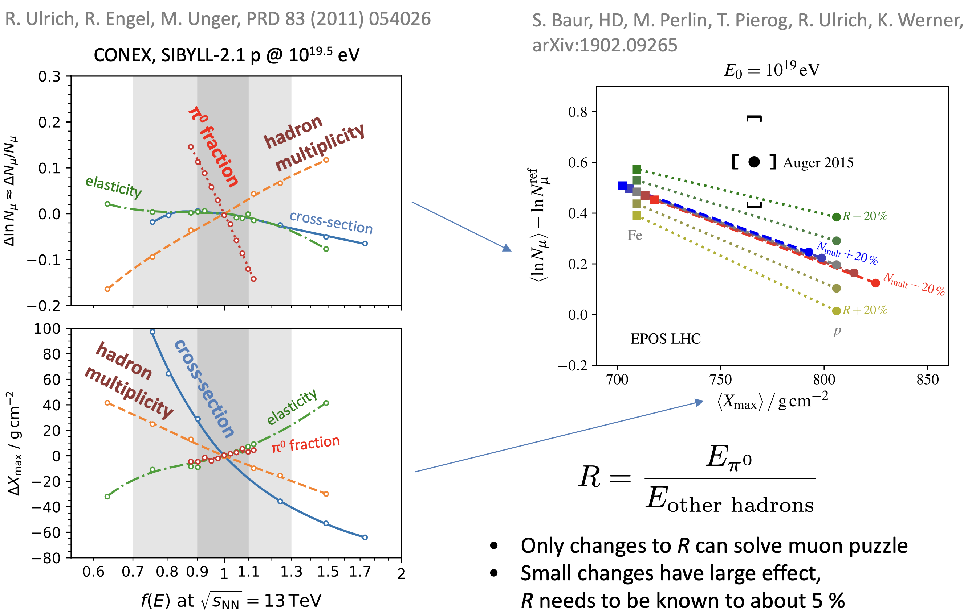
Possible Solutions
Hans Dembinski

Slide 18
Unfolding of event rate – muon bundles
Target
little statistics
Proxy

Slide 19
Unfolding of flux – muon bundles

Slide 20
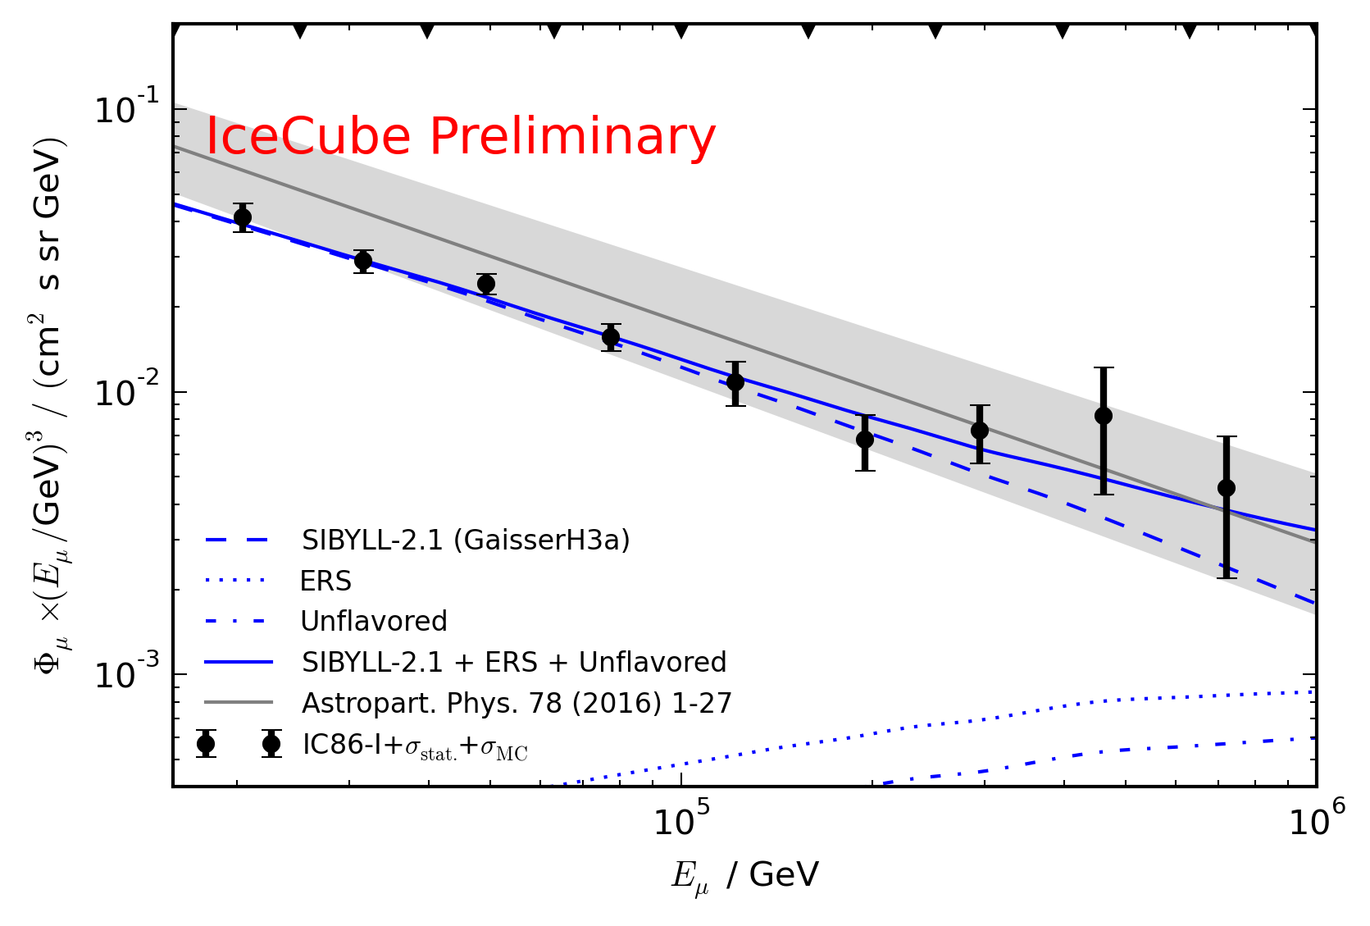
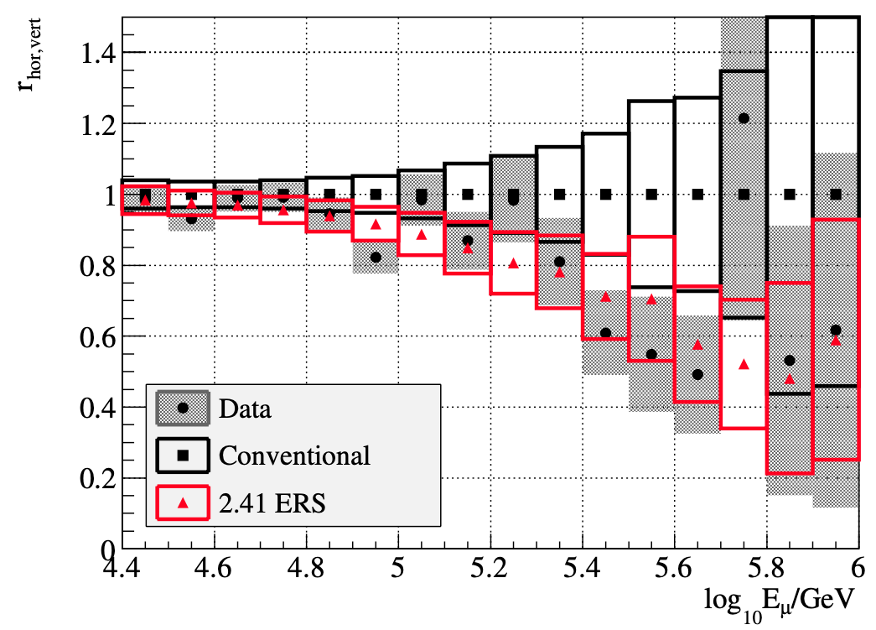
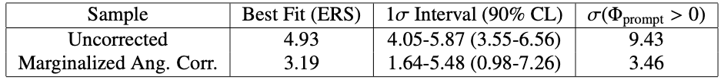
Motivation
Detect and measure normalization of prompt component of atmospheric muon flux
Constrain uncertainties on hadronic interaction models at very high energies
Former analyses:
Leading muon analysis: limited MC statistics (by Tomasz Fuchs, https://wiki.icecube.wisc.edu/index.php/Analysis_of_Leading_Muons)
Characterization of the muon flux: zenith problem (by Patrick Berghaus, https://arxiv.org/abs/1506.07981)
Good analyses with some challenges
Prompt MC truth not available -> new CORSIKA simulations

Slide 21
Overview
Most energetic muon inside
Muon parent:
pion or kaon
Final goals
Measure normalization of the atmospheric prompt muon flux
Unfold muon energy spectrum
Steps for normalization measurement
Verify CORSIKA extended history simulations
Tag prompt muons
Comparisons to MCEq
Set up preliminary analysis chain
Reconstruct muon energy and direction
Data/MC comparisons
Include systematics
Run full statistics simulation
Additional steps for unfolding
Effective area
yes
no
conventional
prompt
✓
Terminology
Muon bundle: all muons in a bundle
Leading muon: most energetic muon in a muon bundle
Single muon: no single muons at high energies
Prompt muon: parent is not pion or kaon
✓
✓
✓
★
★
New (preliminary) CORSIKA Ehist simulation
CORSIKA 77420
SIBYLL 2.3d
600 GeV – 50 EeV
/data/sim/IceCube/2023/generated/CORSIKA_EHISTORY/

Slide 22
Intention
For today
General update
For the upcoming collaboration meeting
Ask for WG reviewer
Storage request for large-scale CORSIKA extended history simulation

Slide 23

What we have done
★
Reconstruction
Trained networks to reconstruct several properties
Selection
Level 3 (L2MuonFilter + 200 TeV bundle energy cut at surface)
Level 4 (add reconstructions)
Data-MC
Check several properties
Largest mismatch in z-vertex
Forward fit
Test NNMFit for analysis
Unfolding
Unfold event rate
Calculate effective area
New simulations
Preparation for large scale IceProd simulation (latest software, switch some options)
Wiki
Created and uploaded (wiki)
★
★
★
★
★
Today:
Münster:
★
★

Slide 24
DNN reconstructions

Slide 25
Reconstructed properties
Energy
entry_energy: Leading muon energy at the detector entry
bundle_energy_at_entry: Muon bundle energy at the detector entry
muon_energy_first_mctree: Leading muon energy at surface
bundle_energy_in_mctree: Muon bundle energy at surface
Track geometry
Length: Propagation length of muon in the ice
LengthInDetector: Propagation length of muon in the detector
center_pos_x: Closest x position of muon to center of the detector
center_pos_y: Closest y position of muon to center of the detector
center_pos_z: Closest z position of muon to center of the detector
center_pos_t: Time of closest approach to the center of the detector
entry_pos_x: x position of muon at the detector entry
entry_pos_y: y position of muon at the detector entry
entry_pos_z: z position of muon at the detector entry
entry_pos_t: Time of muon at the detector entry
Direction
zenith: Zenith angle of muon
azimuth: Azimuth angle of muon
Network 1
Network 2
Network 3

Slide 26
DNN Reconstructions
Reconstruct
Energy
Track geometry
Direction
Physics motivation
Muons lose energy stochastically
High leadingness: energy depositions are dominated by large stochastic losses
Low leadingness: stochastic losses sum up and appear continuously
High energies: forward production
High leadingness: small bundle radius
Low leadingness: larger bundle radius

Slide 27
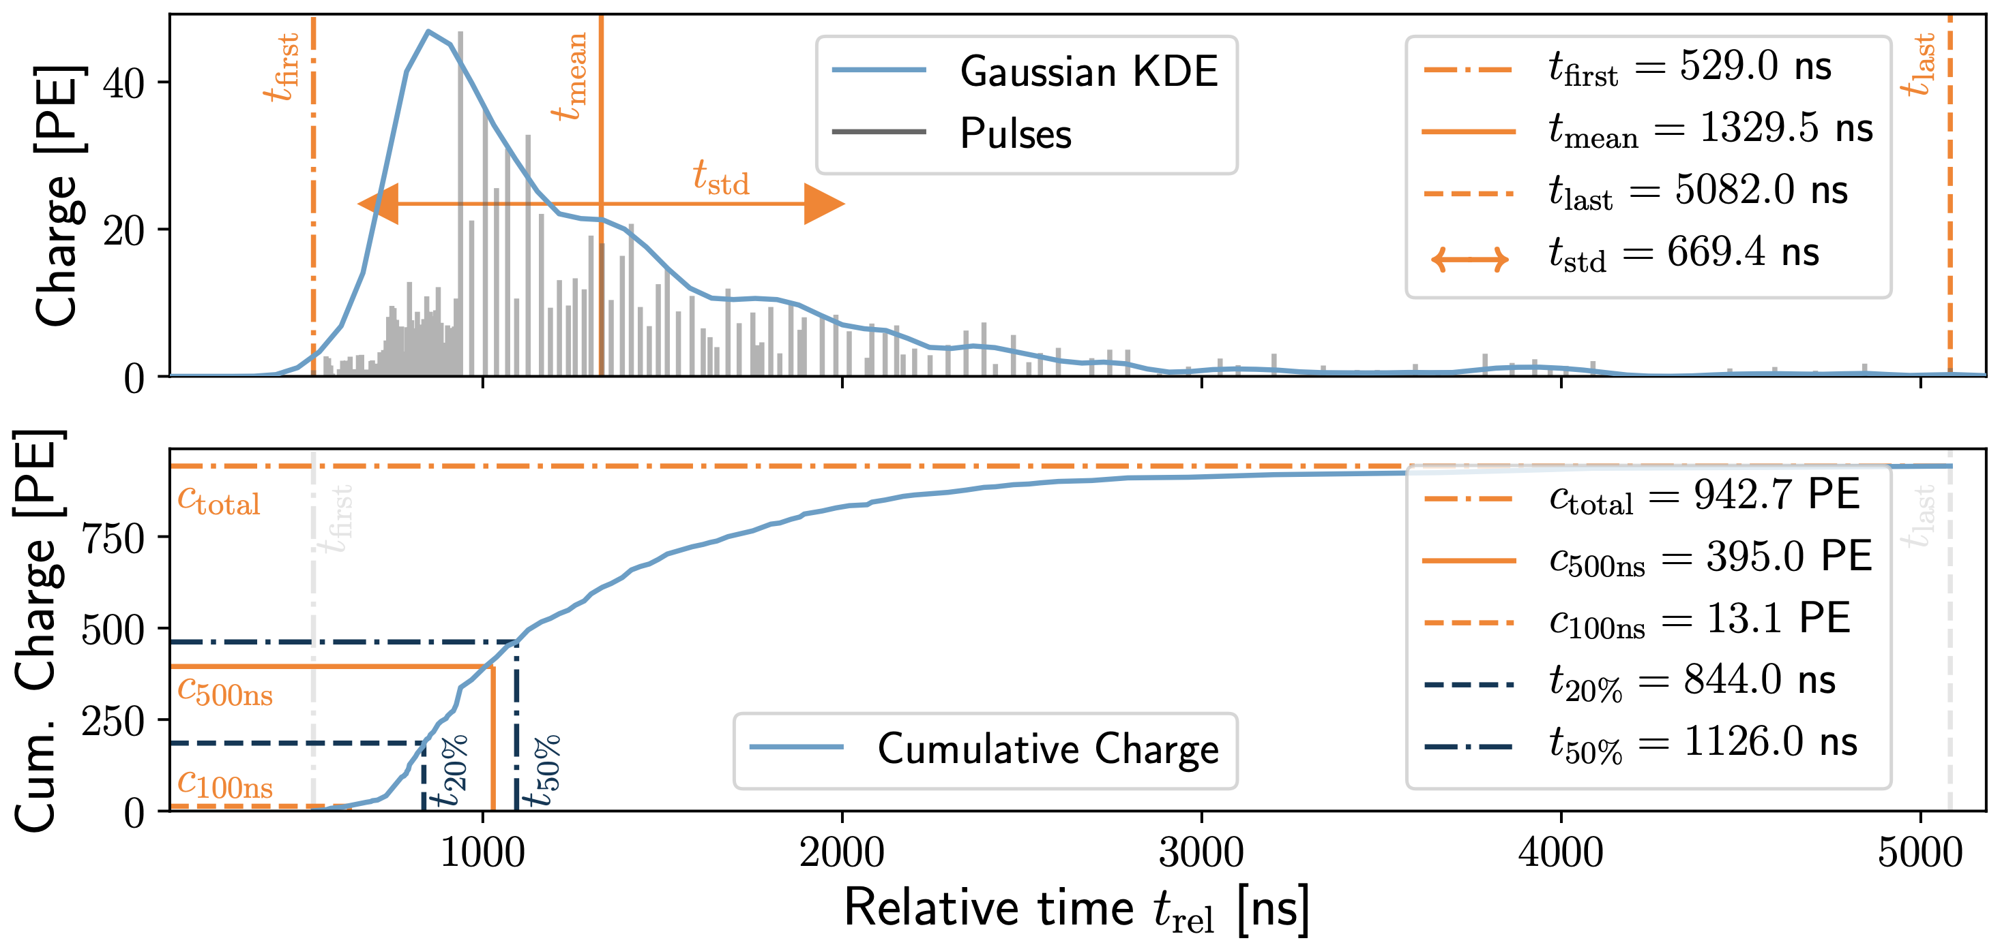
Input data per DOM
10.1088/1748-0221/16/07/P07041
3 inputs
c_{total}: Total charge
Sum of charge
t_{first}: Relative time of first pulse
Relative to total time offset, calculated as the charge weighted mean time of all pulses
t_{std}: Standard deviation of first pulse
Charge weighted standard deviation of pulse times relative to total time offset
9 inputs
t_{last}: Relative time of last pulse
Relative to total time offset, calculated as the charge weighted mean time of all pulses
t_{20%}: Relative time of 20% charge
Relative to total time offset, calculated as the charge weighted mean time of all pulses
t_{50%}: Relative time of 50% charge
Relative to total time offset, calculated as the charge weighted mean time of all pulses
t_{mean}: Mean time
Charge weighted mean time of all pulses relative to total time offset
c_{500ns}: Charge at 500ns
Sum of charge after 500ns
c_{100ns}: Charge at 100ns
Sum of charge after 100ns
Input pulses
SplitInIceDSTPulses
SplitInIceDSTPulsesTWCleaning6000ns
(DNN framework performs an internal cleaning)
Training datasets
20904
21962
22020
22187

Slide 28
Network evaluation - Energy

Slide 29
Bundle energy at entry – internal cleaned pulses
Median + 90% quantile
Prediction
True

Slide 30
Bundle energy at entry – 6 ms cleaned pulses
Median + 90% quantile
Prediction
True

Slide 31
Leading muon energy at entry – internal cleaned pulses
Median + 90% quantile
Prediction
True

Slide 32
Leading muon energy at entry – 6 ms cleaned pulses
Median + 90% quantile
Prediction
True

Slide 33
Bundle energy at surface – internal cleaned pulses
Median + 90% quantile
Prediction
True

Slide 34
Bundle energy at surface – 6 ms cleaned pulses
Median + 90% quantile
Prediction
True

Slide 35
Leading muon energy at surface – internal cleaned pulses
Median + 90% quantile
Prediction
True

Slide 36
Leading muon energy at surface – 6 ms cleaned pulses
Median + 90% quantile
Prediction
True

Slide 37
Network evaluation - Direction

Slide 38
Zenith – internal cleaned pulses
Median + 90% quantile
Prediction
True

Slide 39
Zenith – 6 ms cleaned pulses
Median + 90% quantile
Prediction
True

Slide 40
Azimuth – internal cleaned pulses
Median + 90% quantile
Prediction
True

Slide 41
Azimuth – 6 ms cleaned pulses
Median + 90% quantile
Prediction
True

Slide 42
Angular resolution – internal cleaned pulses
Median + 90% quantile
Prediction
True

Slide 43
Angular resolution – 6 ms cleaned pulses
Median + 90% quantile
Prediction
True

Slide 44
SplineMPE – DNN and conventional seeds
SplitInIceDSTPulsesTWCleaning6000ns

Slide 45
SplineMPE – DNN seeds
SplitInIceDSTPulsesTWCleaning6000ns
DNN contours

Slide 46
SplineMPE – duration per event
DNN contours
Only small improvement at energies around 1 PeV
Countours are larger
Additional runtime
-> Use only DNN reconstruction, since we do not need the best angular resolution (zenith is more important)

Slide 47
Network evaluation – Track geometry
The evaluation of the track geometry works fine and can be found in the wiki

Slide 48
Selection – Level 3
L2 muon filter
200 TeV bundle energy cut at surface
Add labels

Slide 49
L2 filter
Fraction rejected events | All energies | Leading energy > 10 TeV | Leading energy > 100 TeV
MuonFilter | 0.93 | 0.28 | 0.06
HQFilter | 0.99 | 0.74 | 0.18
L2 rate: 369.43 Hz
Rate after muon filter: 24.62 Hz
Choose muon filter to remove large amount of statistics at low energies

Slide 50
Bundle energy cut
Rate after muon filter: 24.62 Hz
If the process of 1 event needs 1 second, 8h run takes 200h -> needs to be reduced!
Use small, fast network to remove low energy events -> target rate 125 mHz
CPU runtime: 11 ± 1ms
GPU
Network: precut_surface_bundle_energy_3inputs_6ms_01

Slide 51
Rejection efficiency - all events
Cut on bundle energy at entry
Cut on bundle energy at surface

Slide 52
Rejection efficiency – small zenith
No difference

Slide 53
Rejection efficiency – high zenith
At high zenith angles, events with high energies are removed with a cut on the bundle energy at entry
Difference!
Rate after muon filter: 24.62 Hz
Rate after bundle cut: 144 mHz
Perform 200 TeV cut on bundle energy at surface

Slide 54
Selection – Level 4
Add DNN network reconstructions

Slide 55
Add DNN networks
Internal DNN pulse cleaning leads to slightly better results
Network | Preprocess / ms | CPU / ms | GPU / ms
direction_9inputs_uncleaned_medium_01 | 22 ± 20 | 106 ± 42 | 5 ± 38
leading_bundle_surface_leading_bundle_energy_OC_inputs9_large_log_02 | 22 ± 20 | 144 ± 56 | 3 ± 13
track_geometry_9inputs_uncleaned_01 | 22 ± 20 | 106 ± 42 | 3 ± 10
precut_surface_bundle_energy_3inputs_6ms_01 (added in level 3) | 1 ± 1 | 11 ± 1 | 7 ± 4

Slide 56
What we have discussed today
✓
✓
Reconstruction
Trained networks to reconstruct several properties
Selection
Level 3 (L2MuonFilter + 200 TeV bundle energy cut at surface)
Level 4 (add reconstructions)
Data-MC
Check several properties
Largest mismatch in z-vertex
Forward fit
Test NNMFit for analysis
Unfolding
Unfold event rate
Calculate effective area
New simulations
Preparation for large scale IceProd simulation (latest software, switch some options)
Wiki
Created and uploaded (wiki)
✓
✓
✓
Collaboration meeting
Ask for WG Reviewer
Storage request large-scale simulation
✓
✓
Thank you for your attention ☺️

Slide 57
Backup

Slide 58
Leading muon energy fraction - leadingness
True muon energy fraction is smeared
Network tries to predict the median of the distribution

Slide 59
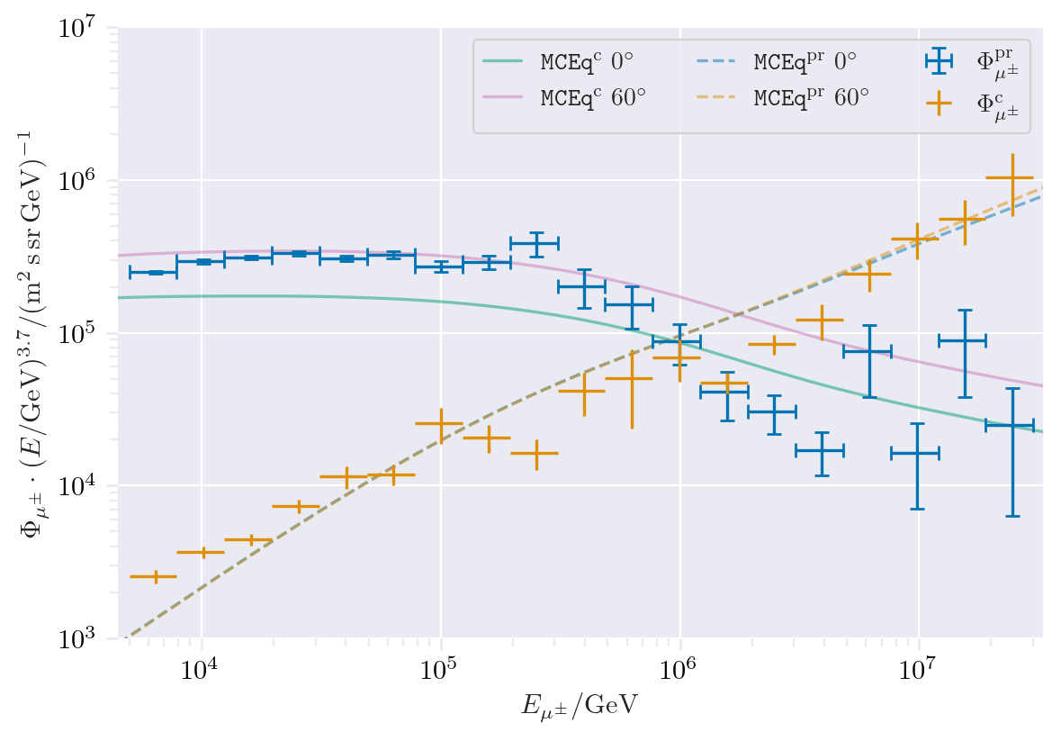
CORSIKA vs. MCEq
Most energetic muon inside
Muon parent:
pion or kaon
Presented by Ludwig Neste
yes
no
Good agreement
conventional
prompt
CORSIKA standalone
IceCube CORSIKA step 0

Slide 60
MC data exploration

Slide 61
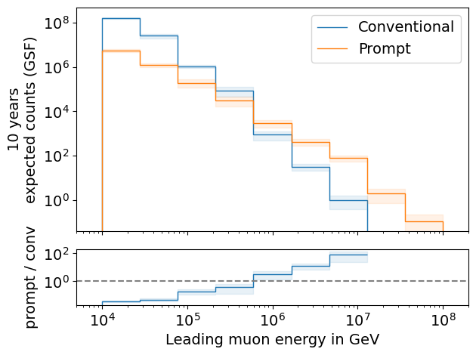
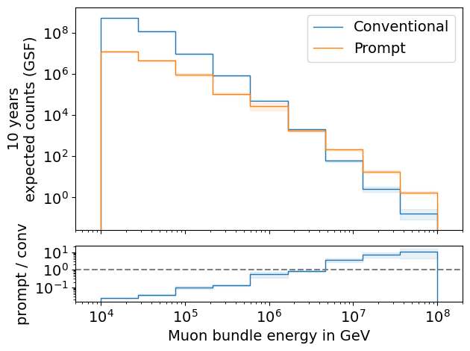
Expected muons for 10 years: leading vs. bundle energy (GSF)
L2 MuonFilter
L2 MuonFilter
Both leading and bundle energy are sensitive to detect prompt
Leading muon energy is more sensitive

Slide 62
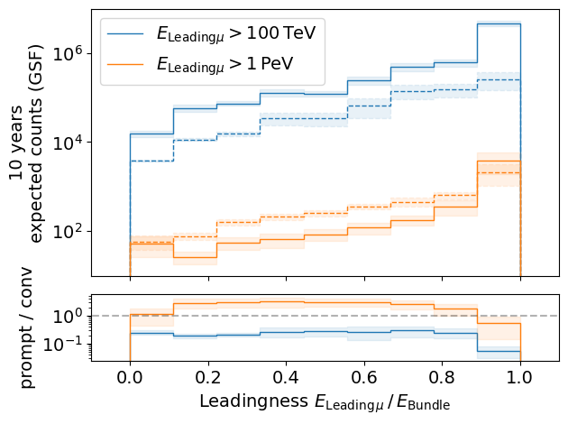
Leading muon energy fraction
Solid: conventional
Dashed: prompt
Prompt dominates for energies > 1 PeV
Leading energy sweet spot: 0.1 – 0.9

Slide 63
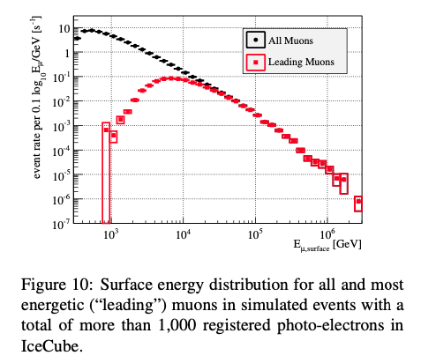
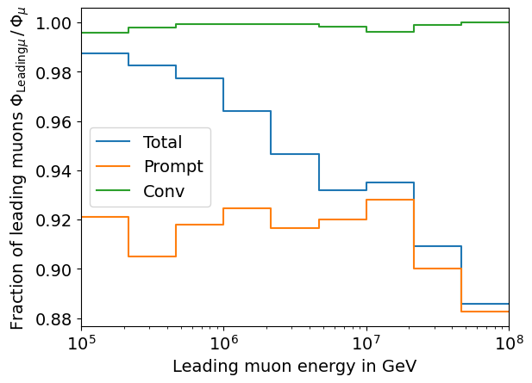
Leading muon contribution
Patrick Berghaus
Muons with energies between 100 TeV and 50 PeV dominate the bundle by more than 90%
In average conventional muons are more dominant than prompt
But: at high energies, there are more prompt than conventional events
High leading energy fraction does not lead to more sensitivity to detect prompt

Slide 64
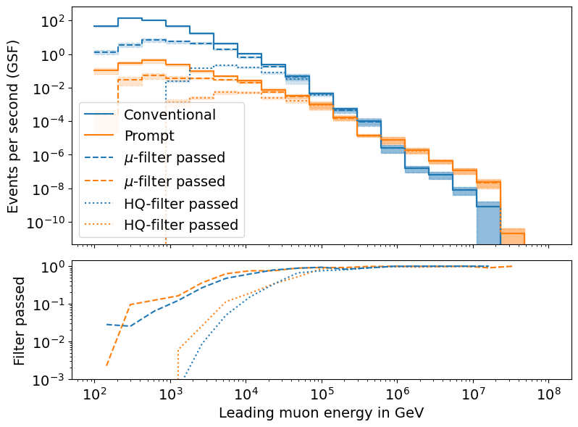
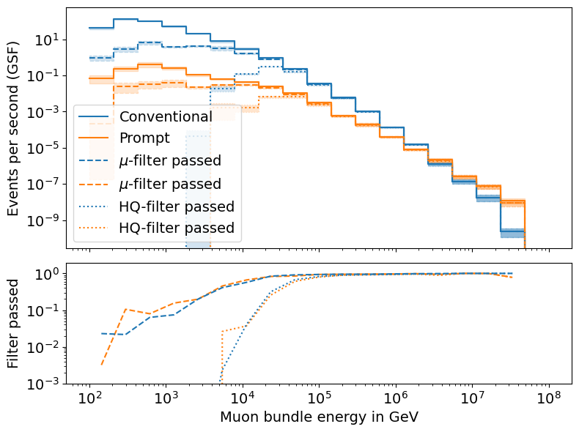
L2 Filters
Fraction events rejected | All energies | Leading energy > 10 TeV | Leading energy > 100 TeV
MuonFilter | 0.93 | 0.28 | 0.06
HQFilter | 0.99 | 0.74 | 0.18
Choose muon filter to remove large amount of statistics at low energies

Slide 65
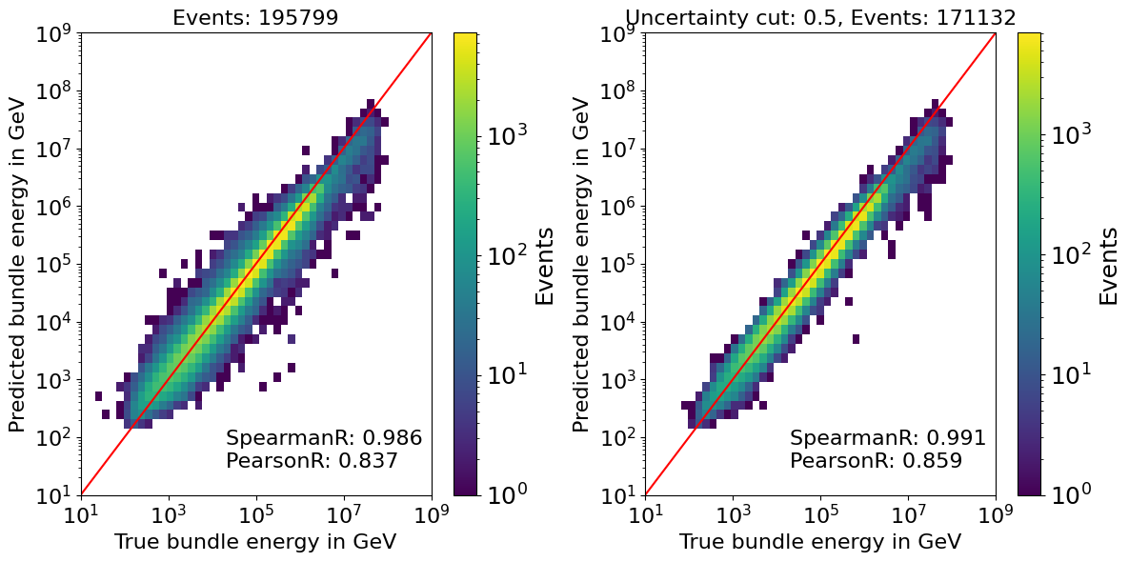
Bundle energy reconstruction

Slide 66
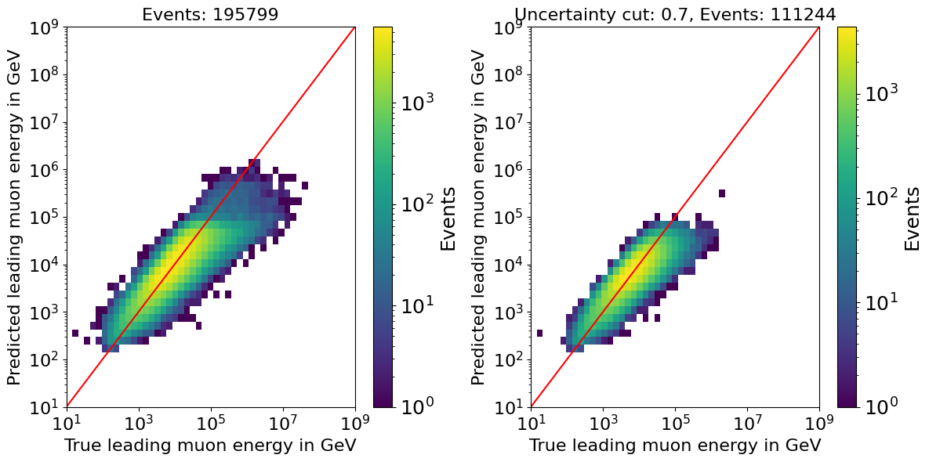
Leading energy reconstruction

Slide 67
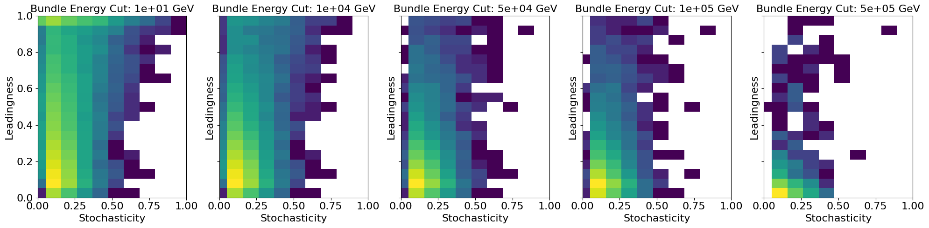
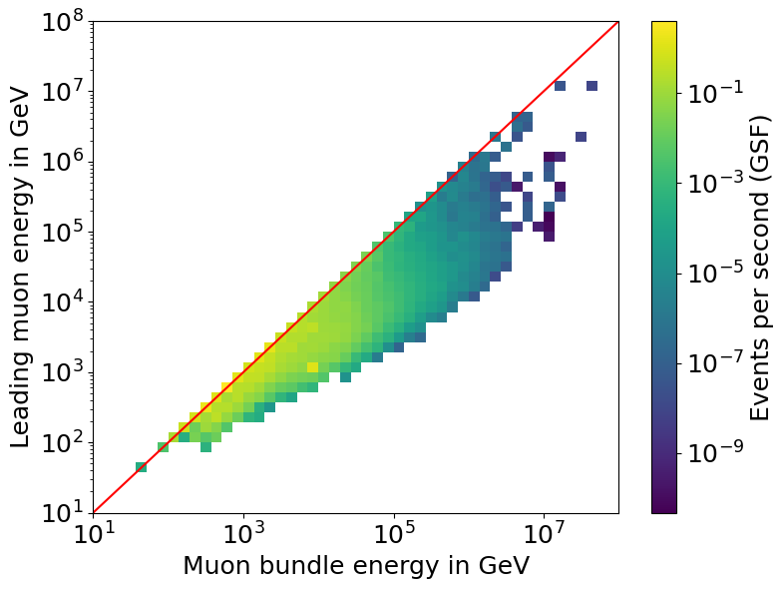
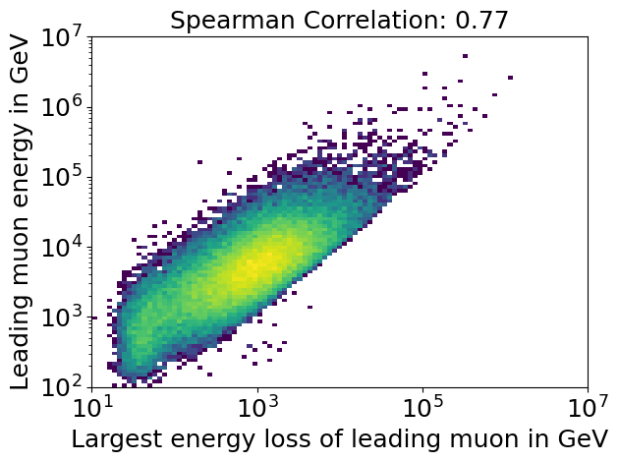
Stochasticity
Bundle energy cut
High stochasticity leads to high leadingness, but only for a small number of events
Leading muon energy smears out at large bundle energies
Largest energy loss of the leading muon correlates with the leading muon energy

Slide 68
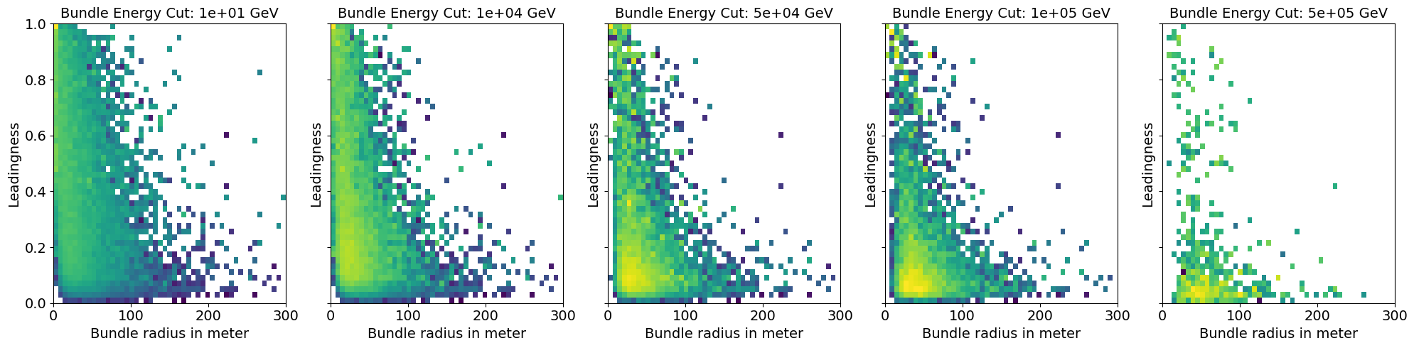
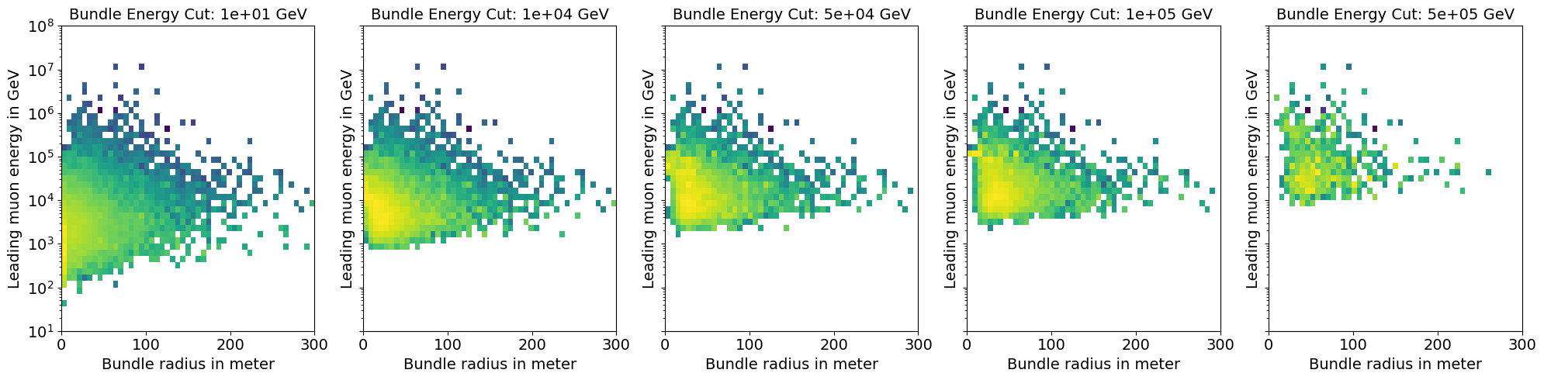
Bundle radius
Bundle energy cut
Large bundle radius leads to low leadingness

Slide 69
Data/MC

Slide 70
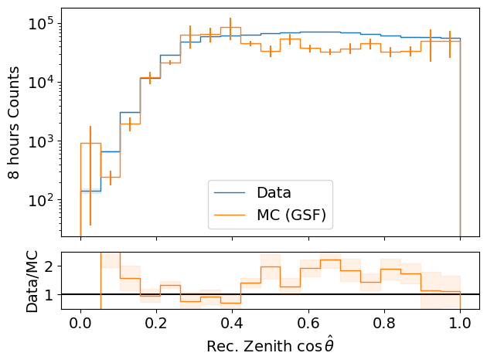
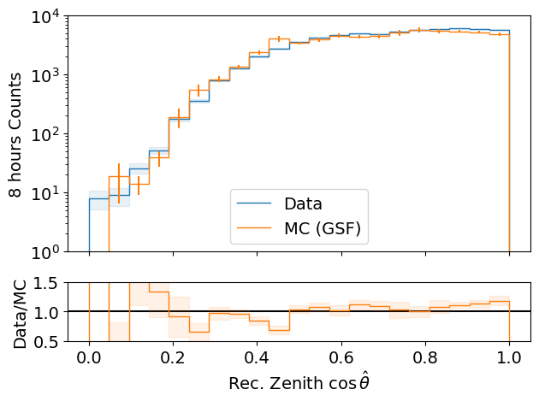
Data-MC: cos(zenith)
processed 8h of experimental data (June 4th, 2020)
L2 MuonFilter
Bundle energy > 100 TeV
L2 MuonFilter
Deviations at low cos(zenith), but very small statistics
More data at cos(zenith) > 0.5
Less data at cos(zenith) ~ 0.3

Slide 71
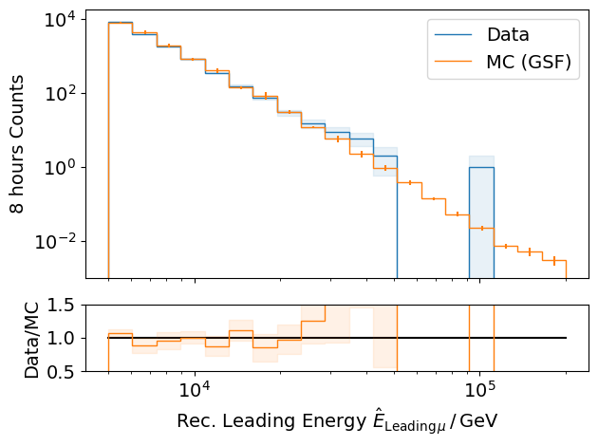
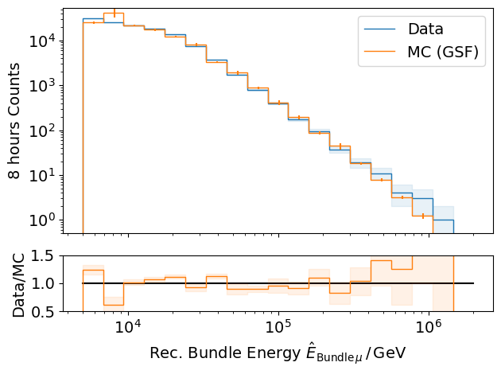
Data-MC: energy spectrum
processed 8h of experimental data (June 4th, 2020)
L2 MuonFilter
L2 MuonFilter
Bundle energy: good agreement with GSF up to 300 TeV
But insufficient statistics

Slide 72
Pseudo analysis

Slide 73
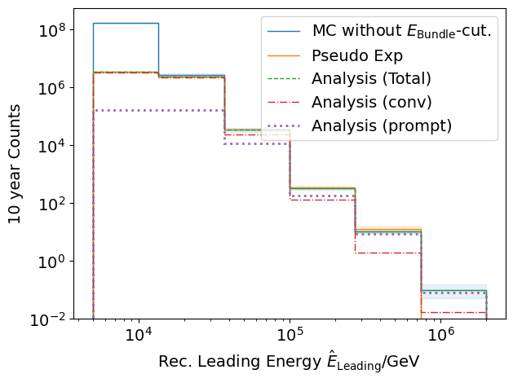
Pseudo data sampling
Cuts:
L2 MuonFilter
Bundle energy > 100 TeV
Tagging allows scaling of prompt by factor n_{pr}

Slide 74
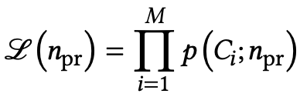
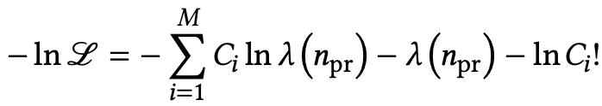
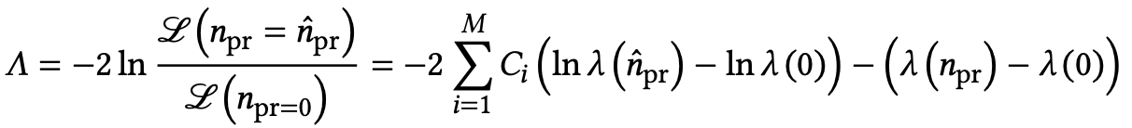
Poisson likelihood fit performed in leading muon energy
Test bias
Cuts:
MuonFilter
Bundle energy > 100 TeV
Prompt scaling/normalization
MC counts per bin i
Conv norm = 1
Experimental counts
Maximize likelihood
With a constant conv norm:
bin counts depend only on prompt norm
= expectation value per bin
Easier:
minimize negative
log-likelihood
Test statistic for Wilks’ theorem
Bias starts at a prompt normalization of 0.1
Null hypothesis: no prompt

Slide 75
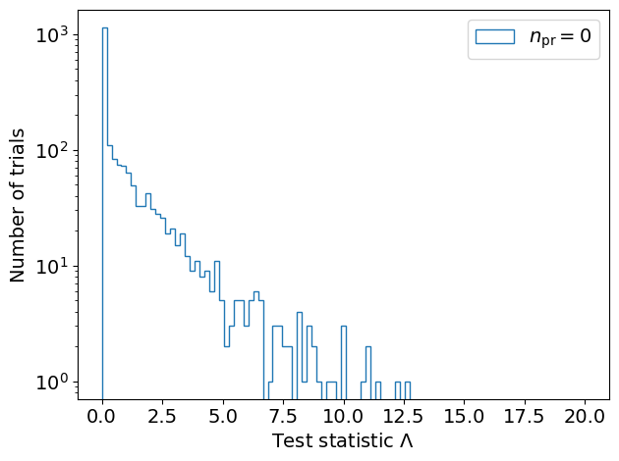
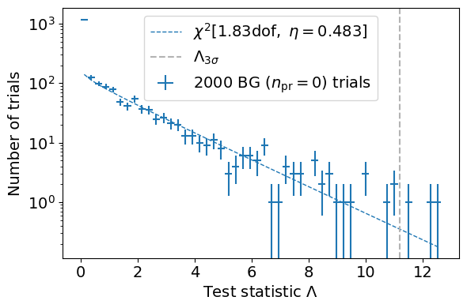
Test background statistics
Cuts:
L2 MuonFilter
Bundle energy > 100 TeV
Background statistic is 𝛘² – distributed
Assume Wilks’ theorem for test statistics

Slide 76
Discovery potential and sensitivity
Cuts:
L2 MuonFilter
Bundle energy > 100 TeV
Expectation for 1 year:
5 sigma discovery potential: 0.102 ± 0.005
Sensitivity: 0.024 ± 0.001
Expectation for 10 years:
5 sigma discovery potential: 0.032 ± 0.001
Sensitivity: 0.007 ± 0.000
Caution:
Limited MC statistics -> events are oversampled in pseudo dataset

Slide 77
Conclusion and outlook
Next goal
Measure normalization of the atmospheric prompt muon flux
Steps for normalization
Verify CORSIKA extended history simulations
Tag prompt muons (see talk by Ludwig Neste)
Comparisons to MCEq (see talk by Ludwig Neste)
Set up preliminary analysis chain
Reconstruct muon energy and direction
Data/MC comparisons
Include systematics
Run full statistics simulation
✓
✓
✓
✓
★
★
Thank you for your attention ☺

Slide 78
Some definitions and wording…
Leading muon
The most energetic muon inside a bundle (no minimum fraction required)
Single muon
Except for stopping and very low energetic muons, there are never any single muons (almost every event is muon bundle)
Prompt muon
Muon parent is not pion or kaon
Suggestion:
To avoid confusion regarding different leading muon definitions we can introduce a “leadingness” (For example: Tomasz used a leadingness of 50%, …)
Most energetic muon inside
Muon parent:
pion or kaon
yes
no
conventional
prompt

Slide 79
Intention
Detect prompt component of the atmospheric muon flux significantly
Measure the normalization
Get handle on hadronic interaction models
Unfold an energy spectrum
Idea:
New CORSIKA simulations with extended history
Tag muons by parent → prompt or conventional
Scale amount of prompt particles
Scaling saves time and resources instead of doing multiple simulations with different interaction models
Perform forward fit of the prompt normalization

Slide 80

Definition of the muon flux
$φ_{tot}=φ_{conventional}+φ_{prompt}$
$π, Κ$ ∝ E^{-3.7}
“not” $π, Κ \text{∝ }\text{E}\text{−}\text{2}\text{.7}$

Slide 81
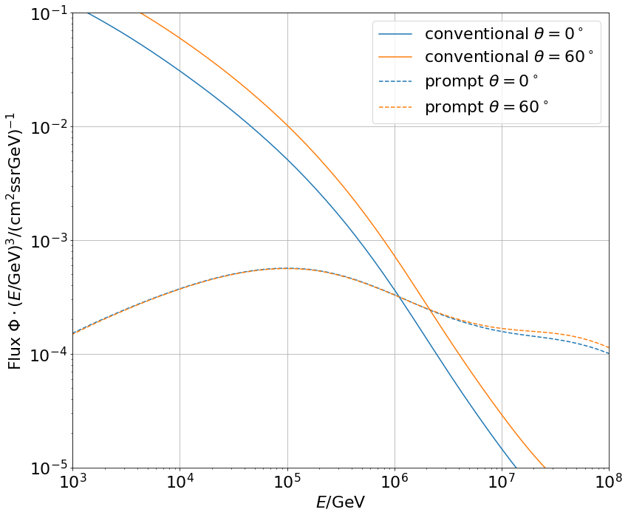
Muon flux
0°: perpendicular to Earth’s surface
$$φ_{tot}=φ_{conv}+φ_{prompt}$$
Prompt dominates at energies larger than PeV
Conventional particle flux depends on zenith angle
conventional
prompt
We can measure prompt muon energies from ~1 PeV to ~100 PeV

Slide 82
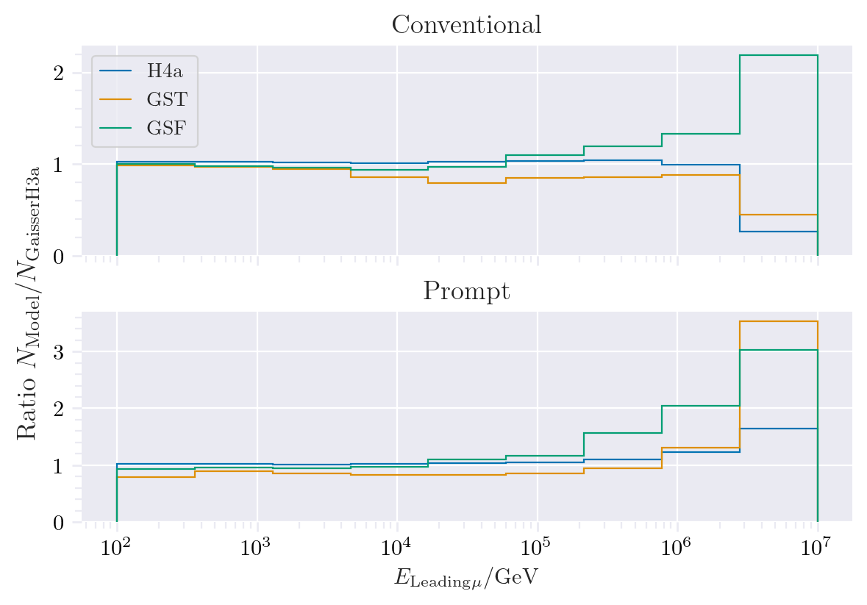
Muon production – different weightings
GST predicts most prompt
MCLabelsLeadingMuons_entry_energy

Slide 83
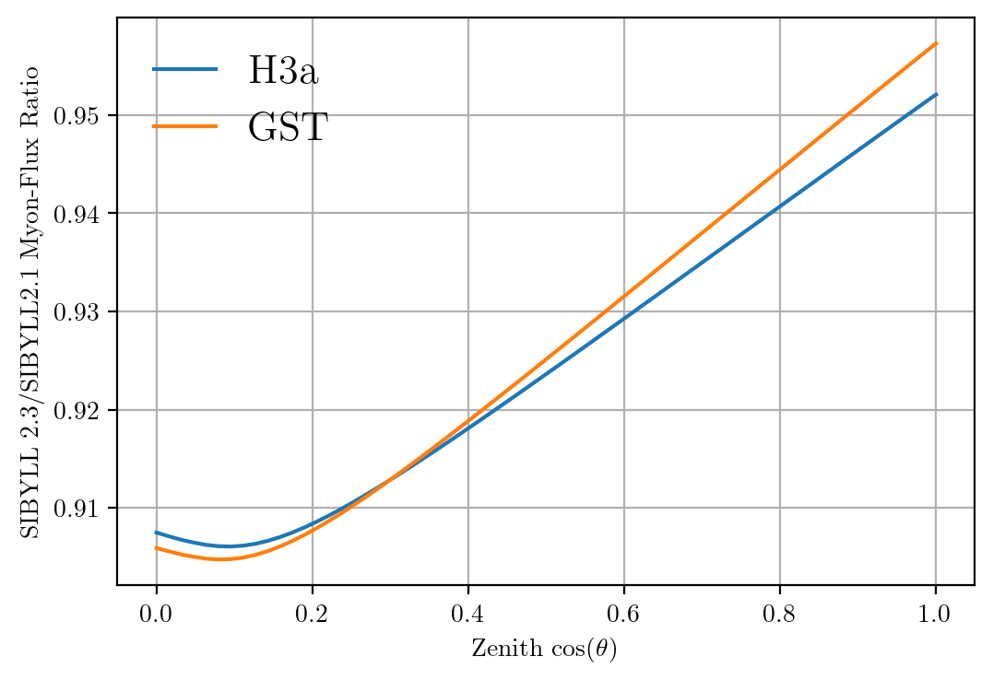
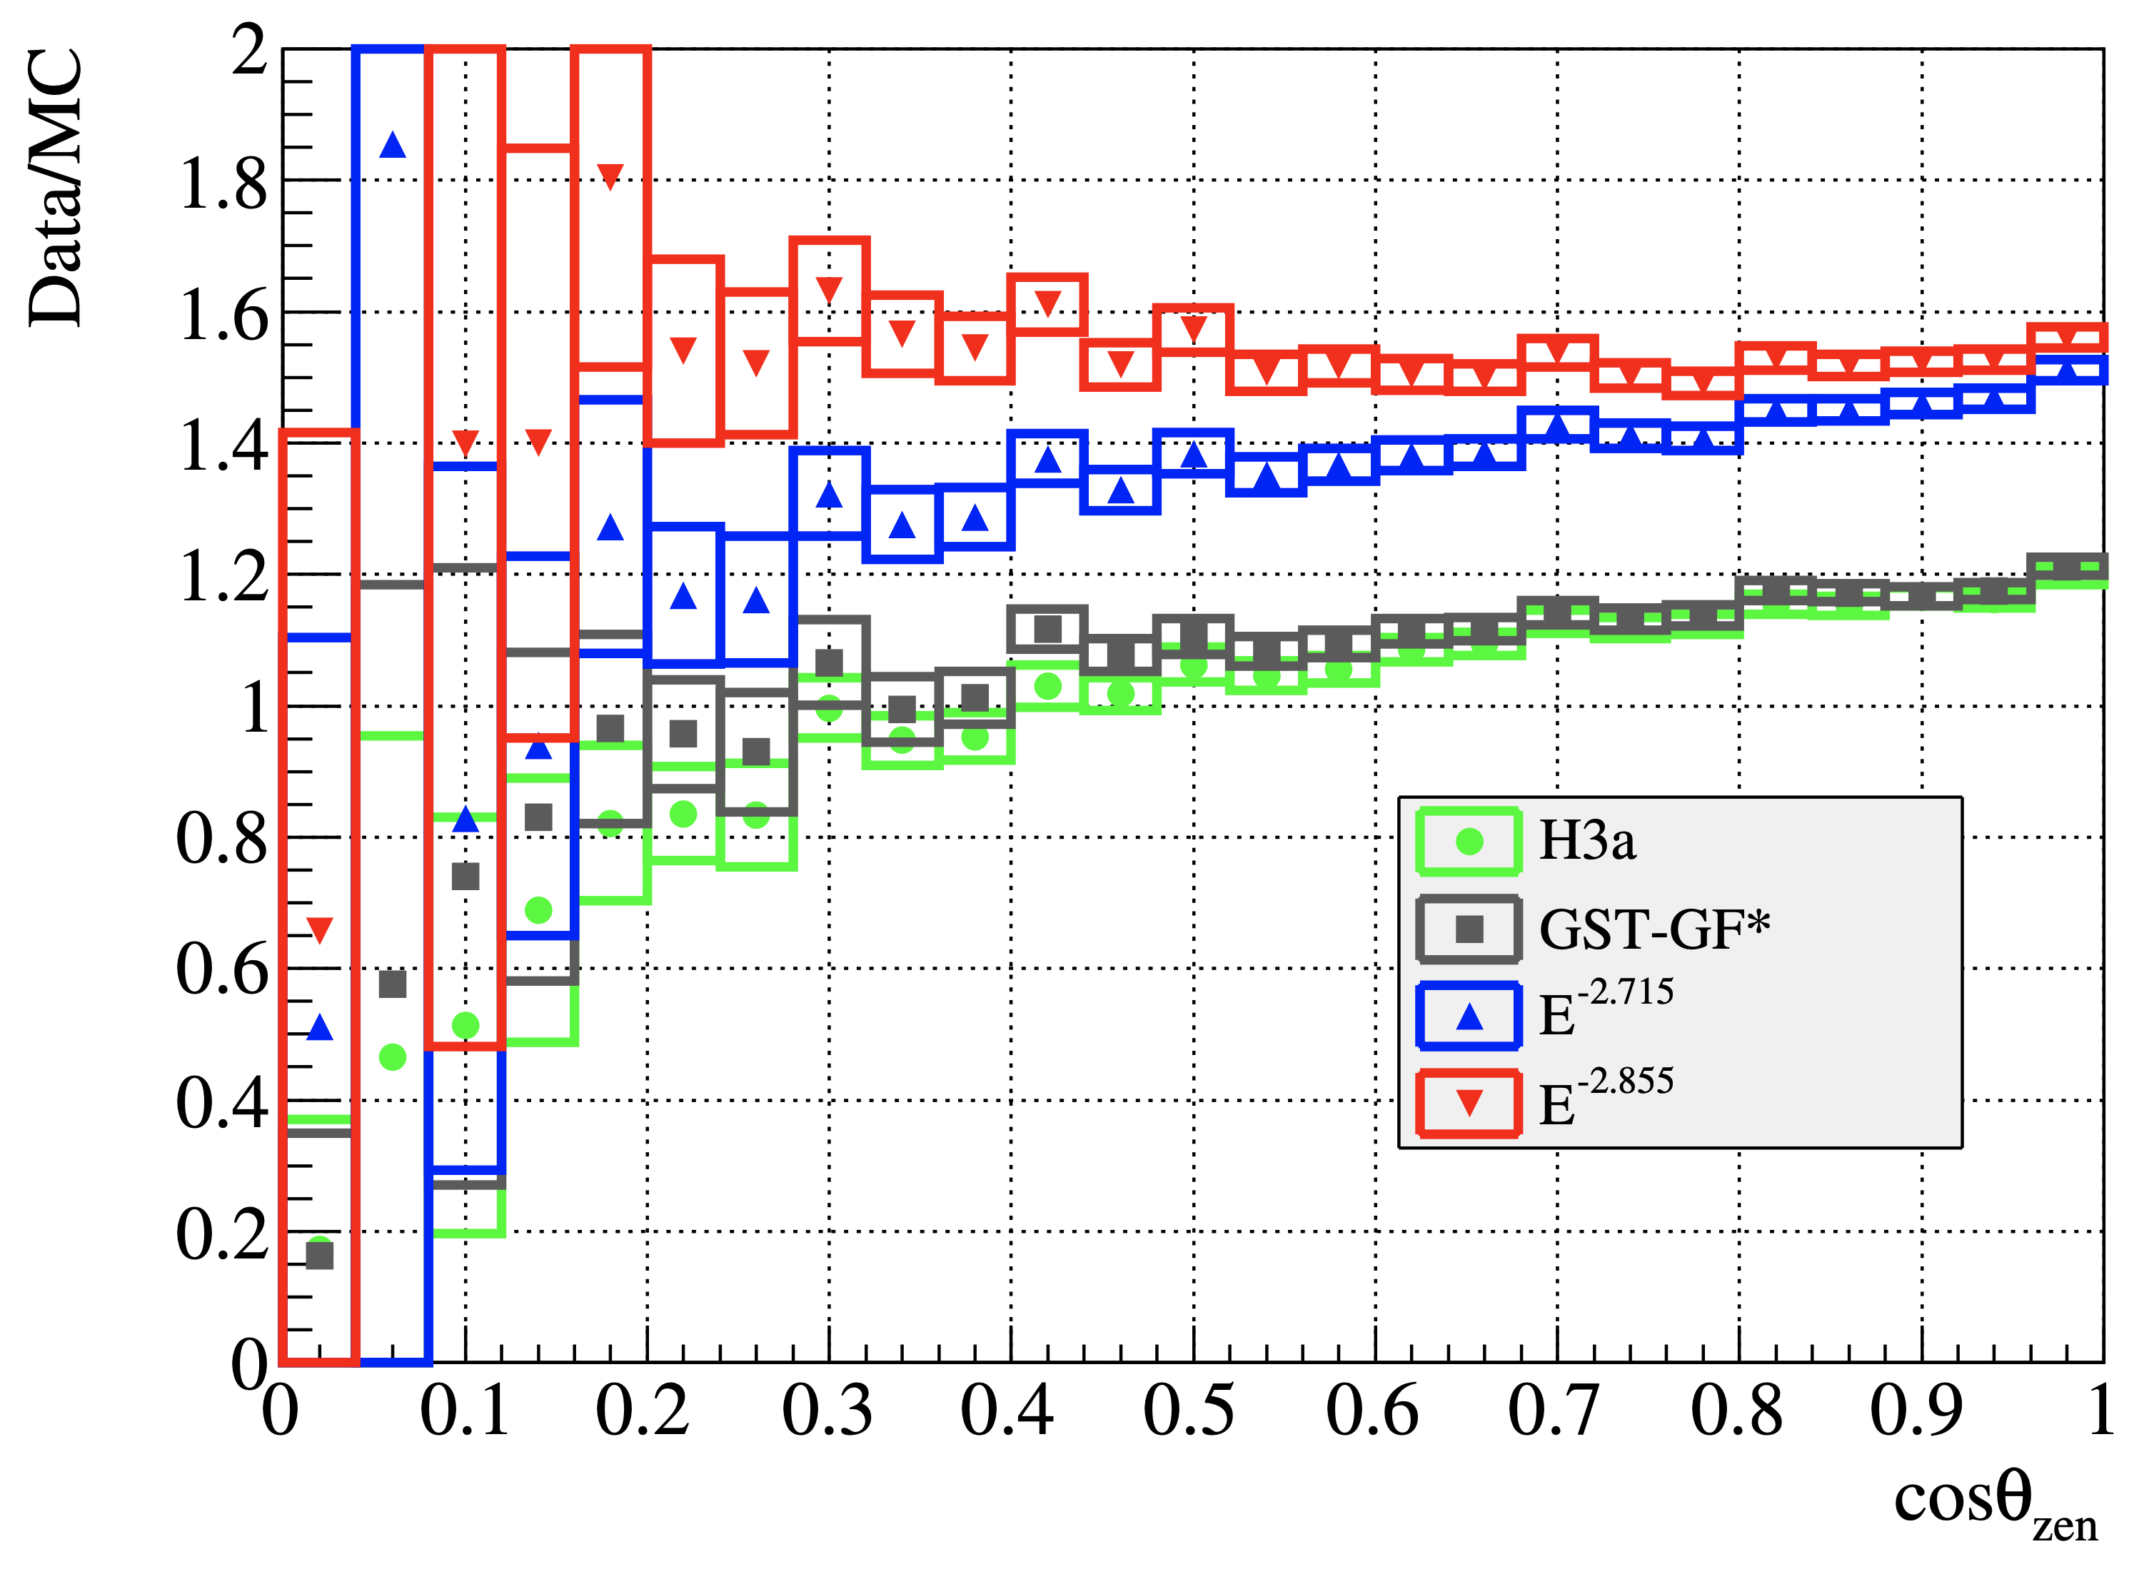
Solution to zenith problem?
No complete solution, but a step in the right direction

Slide 84
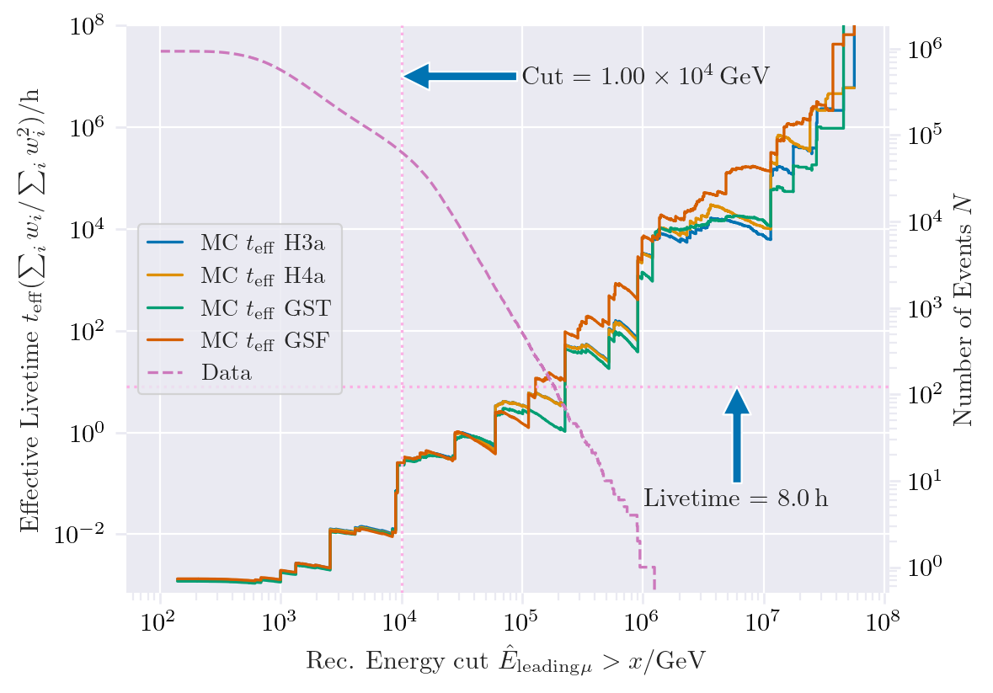
New CORSIKA extended history simulations
CORSIKA 77420
SIBYLL 2.3d
Icetray 1.5.1
5 components (p, He, N, Al, Fe)
Polyplopia: True
Trimshower: True
Ecuts1: 273 GeV (hadron min energy)
Ecuts2: 273 GeV (muon min energy)
Ecuts3: 10²⁰ GeV (electron min energy)
Ecuts4: 10²⁰ GeV (photon min energy)
4 datasets:
30010: 600 GeV – 1 PeV
30011: 1 PeV – 100 PeV
30012: 100 PeV – 1 EeV
30013: 1 EeV – 50 EeV
/data/sim/IceCube/2023/generated/CORSIKA_EHISTORY/
Please go ahead and test the datasets
Sufficient statistics above 1 PeV
Too few statistics at lower energies

Slide 85


Expected muons for 10 years: leading vs. bundle energy
Solid: conventional
Dashed: prompt
Different primary fluxes lead to different prompt fluxes
Bundle energy extends to higher energies

Slide 86

Simulated events
Passed muon filter

Slide 87


Which energies do we need to simulate?
L2 MuonFilter
Bundle energy > 100 TeV

Slide 88




Filters
Choose muon filter,
larger statistics at 10 TeV

Slide 89

Filters – passed events per leading energy

Slide 90













Data-MC: HitStatistics - SplitInIceDSTPulses
L2 MuonFilter
No further exclusions

Slide 91













Data-MC: HitStatistics - SplitInIceDSTPulses
L2 Muonfilter
Reconstructed bundle energy > 10 TeV
Good agreement for pulses

Slide 92
Evaluation of models used in pseudo analysis
Note: the DNN reconstruction models are still investigated! The models used here are in an early stage. So far, the two bachelor students have trained models with better performance.
Updates on the models and reconstructions are provided in the near future

Slide 93
Data-MC agreements
Two bachelor students worked on reconstructions using the dnn_reco framework (thesis available in english):
Leander Flottau
Benjamin Brandt
Reconstructions:
Leading energy
Leading fraction
Bundle energy
Multiplicity
Azimuth
Zenith
General:
Trained on uncleaned and 6µs cleaned muon pulses
Processed 8h of experimental data (June 4th, 2020)
Work in progress

Slide 94

Zenith reconstructions

Slide 95

Azimuth reconstructions

Slide 96

Angular resolution

Slide 97
Bundle radius - energy

Slide 98

Muon flux – bundle radius

Slide 99


Stochasticity
muon that loses much energy at the beginning
of the propagation
cumulated energy loss
continuous energy loss
track length
calculate the area between the “continuous muon energy loss” and the accumulated muon energy losses and normalize it
high stochasticity: area = 1
no stochasticity: area = 0

Slide 100
Bundle radius
calculate perpendicular distance between leading muon and closest point to detector center
reference point
calculate the distance between the leading muon and all the other muons at the reference point
analyze the distances weighted by their energy (100%, 99%, 95%,... energy containment)

